Slide 1
CS 540 Network Architecture
Lecture 21: DTN
Prof. Younghee Lee

Slide 2
DTN: Delay-Tolerant Network[Fall03]
Challenged Network: Extreme Environments
Deep space communications
Sensor Networks
High stress Physical Environments: Battlefield, civil emergency
Communications challenges
Large delays: TCP.. severely limit TCP’s performance
Intermittent and Scheduled Links: cascaded intermittent links
Heterogeneous Network Architecture
Link security needs
Bandwidth asymmetry
Routing Issues
End to end path may not exist
Limited power: batteries
[Fall03] Kevin Fall, “A Delay-Tolerant Network Architecture for Challenged
Internets, SIGCOMM’03

Slide 3
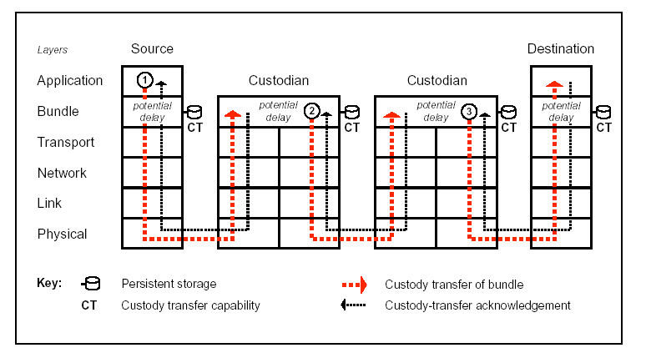
DTN: Delay-Tolerant Network

Slide 4
DTN: Delay-Tolerant Network
Goals
Interoperability across network architectures
Reliability robust to link and node failure: Tolerate delay and disruption
Components
Flexible Naming scheme
Two variable length portions: Region name, entity name
Reliable Message Overlay with Routing: Store and Forward Overlay
Message switching
Use message aggregates or “bundles”
Per-hop Authentication with :Class of Service (CoS)
Similar to the postal service: priority ( low ordinary, high), notification…
Interoperability Gateways

Slide 5
DTN: Delay-Tolerant Network
Reliable Message Overlay with Routing
End-to-End Message Service: “Bundles”
Bundle: a series of contiguous data blocks
each bundle contains enough semantic information to allow the application to make progress
“postal-like” delivery over regional transports
Optional class of service/notification
Allows network’s path selection and scheduling functions a-priori knowledge of the size and performance requirements of data transfers
overlay atop TCP/IP or other (link) layers
Key Idea: Custody Transfer
Custodian owns reliable-delivery guarantee
Bundles transferred between custodians toward destination
Sender may free resources upon successful custody transfer
DTN will operate over existing protocol stacks and provide a gateway when a node touches two or more dissimilar networks

Slide 6
DTN: naming
Endpoint IDs are processed as names
expressed as Internet URI, matched as strings
multicast, anycast, unicast
Late binding of EID permits naming flexibility
EID “looked up” only when necessary during delivery

Slide 7
DTN: Routing
DTN Routing problem
Vertices: buffer limit
Edges:
a possible opportunity to communicate
multigraph for multiple physical connections
Problem: How to optimize some metric of delivery on this structure?
Metric: Reliability?, Delay?...

Slide 8
DTN: Routing
Possible solution?
Replication: flooding/random forwarding/history based forwarding
Highly dependent with applications
Erasure code?
Instead of seeking particular “good” contacts, “split” messages and distribute to more contacts to increase chance of delivery
erasure code:
a forward error correction (FEC) code
transforms a message of k symbols into a longer code word with n symbols such that the original message can be recovered from a subset of the n symbols

Slide 9
DTN: Application?
Battle field
Geoblog, Photo blog
Meteorological data: temperature, solar radiation..
Tracking animal:
Offloading Wireless Internet traffic
Web caching: Large file downloads
Email
…

Slide 10
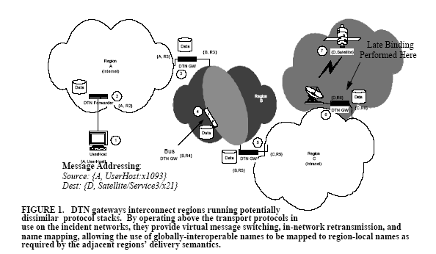
Delay Tolerant Message-Oriented Overlay Architecture

Slide 11
Bundle Routing

Slide 12
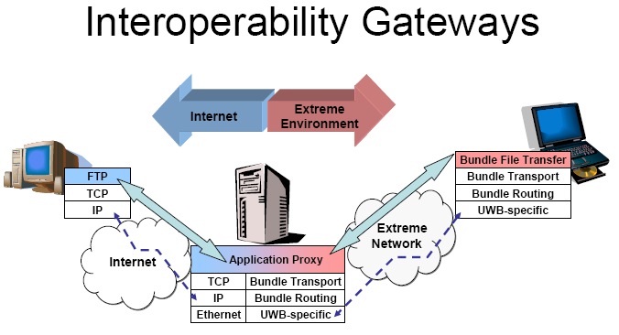
Internetwork Operation, Interoperability Gateways

Slide 13
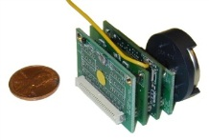


TCP for DTN
Delay Tolerant Network
Reliable Message Overlay with Routing
Overlaid above different protocol stacks in various networks
Store & forward message delivery for non-interactive traffic
a-priori knowledge of communication capacity needs (intermediate storage, retransmission bandwidth)
Destination
Source
Application
Application
Bundle Protocols
Bundle
Protocols
Sensor Transport
Diffusion Routing
TCP
Sensor
Network Region
UWB-specific
Custody
IP
Custody
Internet
Bundle Protocols
TCP
Sensor Transport
IP
Diffusion Routing
Ethernet
UWB-specific
Bundle Protocols
Sensor Transport
Custody
Diffusion Routing
UWB-specific

Slide 14
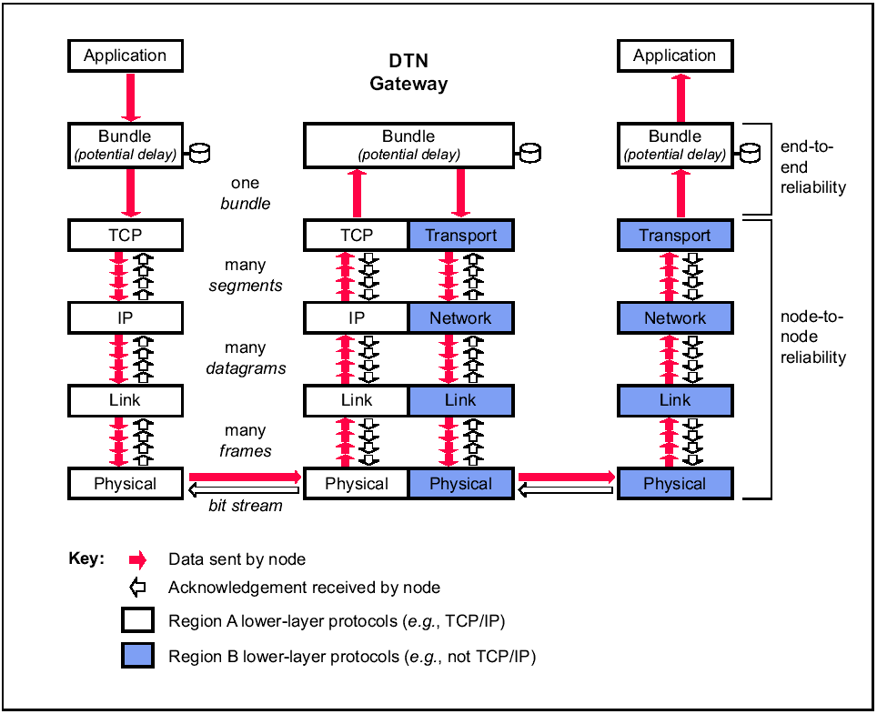
TCP for DTN
Non-faulty Disconnection
Due to motion
Predictable (satellites, busses)
Opportunistic (node coming in range)
Long Queuing Times
Next hop unavailable
Alternative next hops
Persistent storage

Slide 15
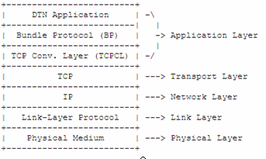
TCP for DTN
IETF DTNRG
TCP convergence layer
"convergence layer adapter" (CLA) to send and receive bundles using an underlying internet protocol.

Slide 16
TCP for DTN
Transport Layer (TCP, SCTP, UDP)
RTT too high for slow start
Waste of bandwidth
False congestion indication
Not many flows on a link
LTP-T: extension of LTP for Transport
Delay-Tolerant Network (DTN) friendly transport protocol.
The Licklider transmission protocol (LTP)
a delay-tolerant point-to-point protocol being developed by the Delay-Tolerant Networking Research Group (DTNRG)
designed to provide retransmission based reliability of data transmissions over deep-space RF links
In the bundling protocol stack designed by DTNRG , it serves as a reliable datalink convergence layer for deep-space links.
Bundling store-and-forward
LTP point-to-point
retransmission
TCP “point-to-point”
retransmission
IP
TM
TC
AOS
Prox-1
Ethernet
R/F, optical
wire

Slide 17
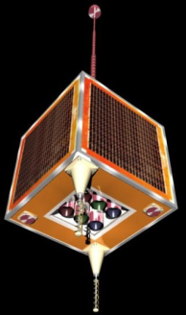
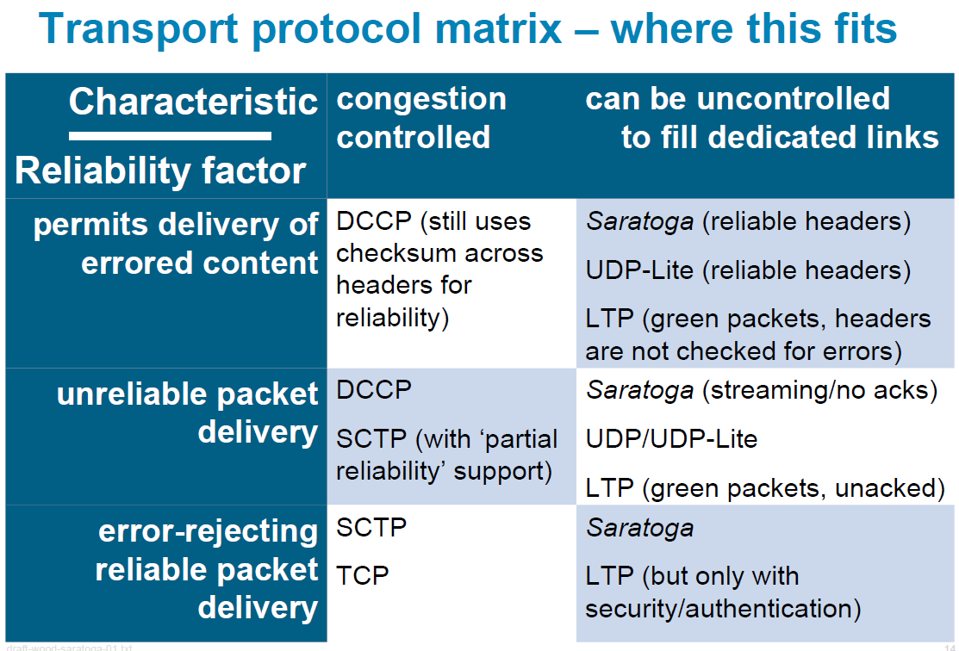
TCP for DTN
Saratoga
a Delay-Tolerant Networking convergence layer with efficient link utilization: for Disaster Monitoring Constellation
Stream Control Transmission Protocol (SCTP) is a Transport Layer protocol, serving in a similar role to the popular protocols TCP and UDP.

